Slide 1
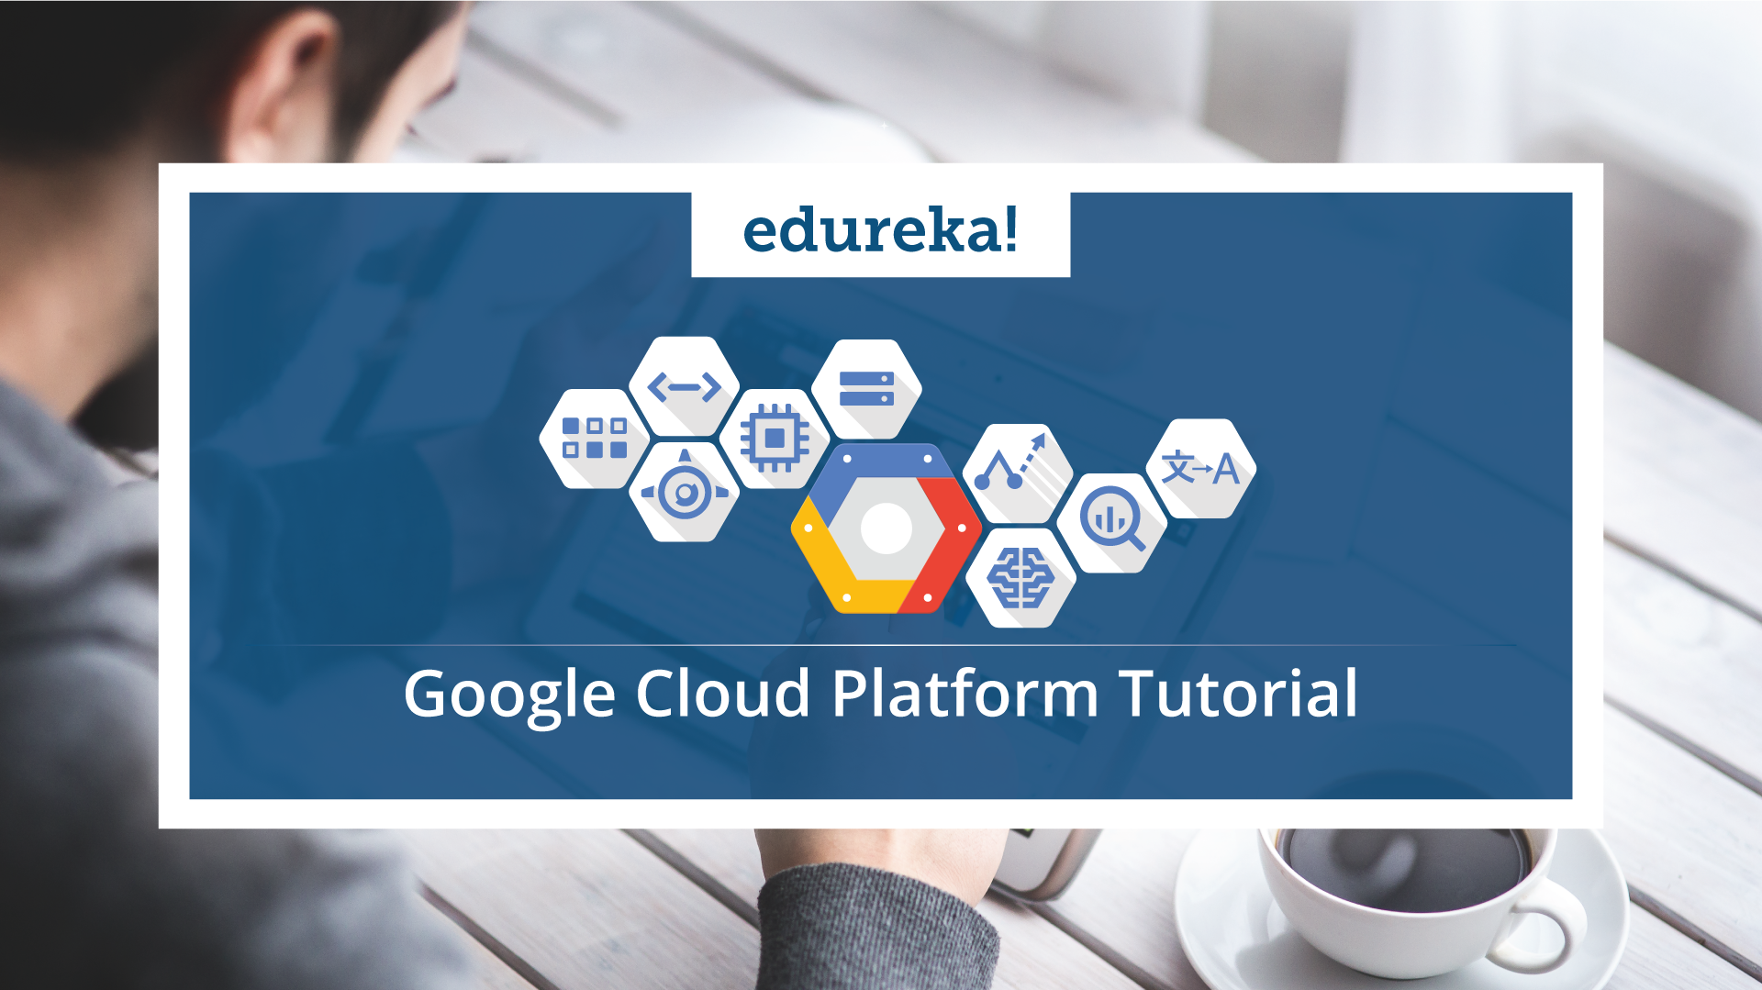

Slide 2

Agenda
  Need of Cloud Computing
  What is Cloud Computing
  Cloud Services and Providers
  Why GCP
  What is GCP
  GCP Services
  Regions and Zones
  GCP Demo

Slide 3


Traditional E-commerce Scenario

Slide 4

Traditional E-commerce Scenario

Slide 5

Traditional E-commerce Scenario

Slide 6

Traditional E-commerce Scenario

Slide 7

Traditional E-commerce Scenario

Slide 8

Traditional E-commerce Scenario
Increased Website
Traffic

Slide 9

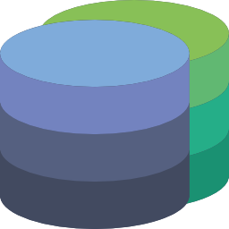
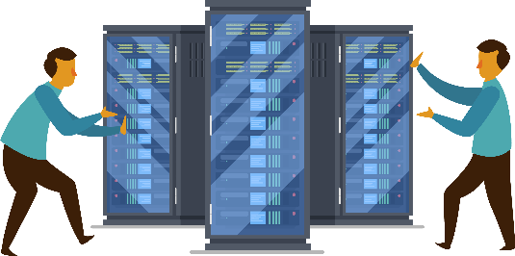








Problems Faced
Database & Security
Managing Servers
Increasing Cost
Scalability Issue
Fast & Fault Tolerant

Slide 10
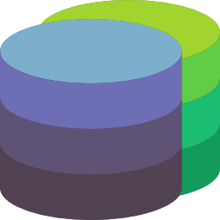
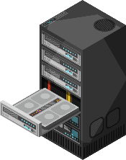
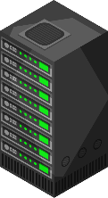



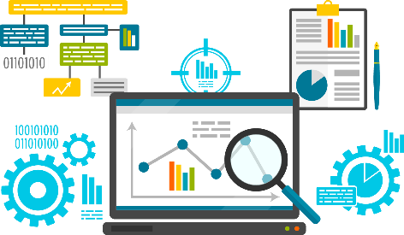

Solution
CLOUD
COMPUTING
Database & Security
Dynamically Scalable Servers
Remote Access to Devices
Fast Computation
Reduced Cost & Overhead

Slide 11
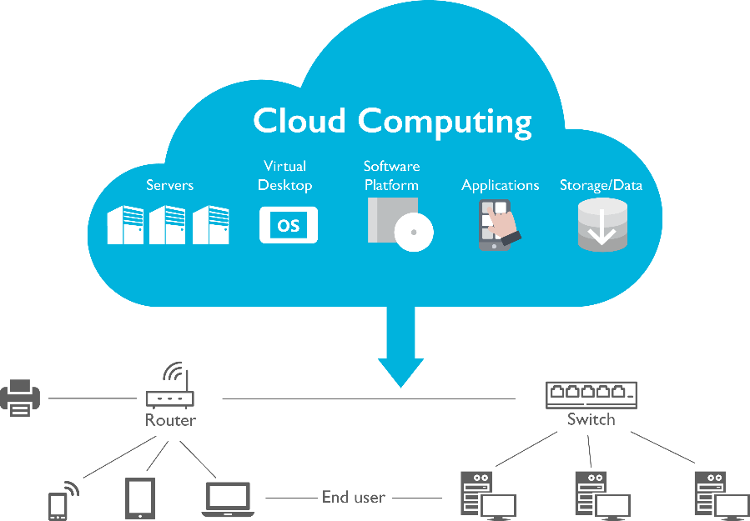
Cloud Computing
Cloud computing is the on-demand delivery of compute power, database storage, applications, and other IT resources through a cloud services platform via the internet with pay-as-you-go pricing
It is the use of remote servers on the internet to store, manage and process data rather than a local server or your personal computer

Slide 12
Cloud Services
On-Premise
Infrastructure as a Service (IaaS)
Platform as a Service (PaaS)
Software as a Service (SaaS)
Applications
Applications
Applications
Applications
Data
Data
Data
Data
Runtime
Runtime
Runtime
Runtime
Middleware
Middleware
Middleware
Middleware
O/S
O/S
O/S
O/S
Virtualization
Virtualization
Virtualization
Virtualization
Servers
Servers
Servers
Servers
Storage
Storage
Storage
Storage
Networking
Networking
Networking
Networking
Managed by Customer
Managed by Provider

Slide 13
Various Cloud Providers

Slide 14

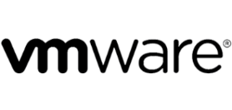

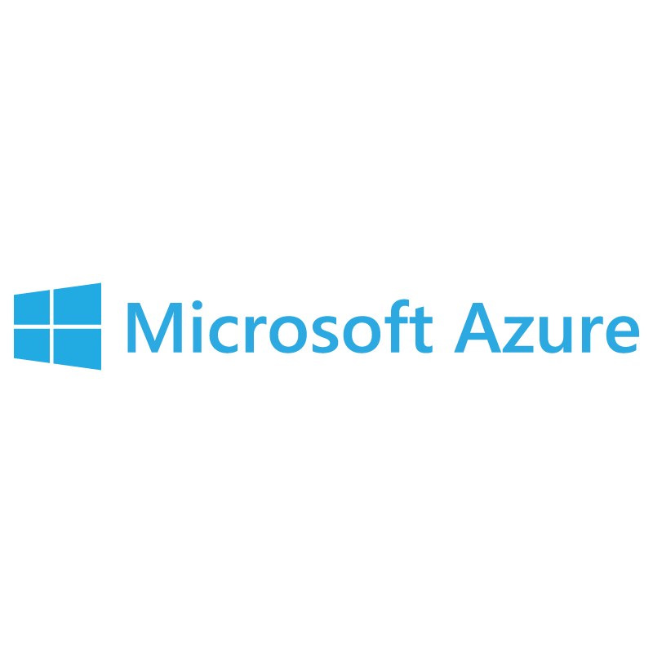
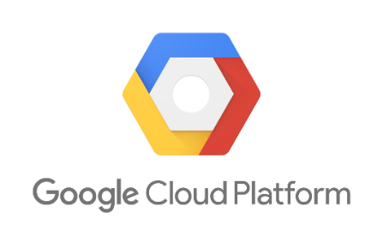

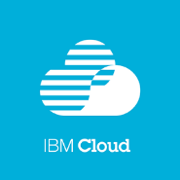


Cloud Providers

Slide 15
Why go for
Google Cloud Platform?

Slide 16
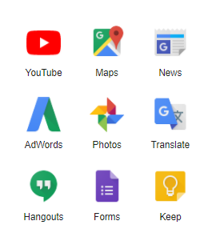
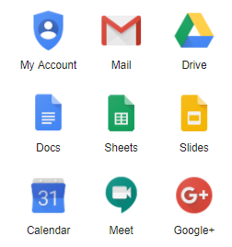
Why GCP?
Google Cloud Platform, is a suite of cloud computing services that runs on the same infrastructure that Google uses internally for its end-user products, such as Google Search, Gmail, Google Photos and YouTube
Notes:
Google Cloud Platform, is a suite of cloud computing services that runs on the same infrastructure that Google uses internally for its end-user products, such as Google Search, Gmail, Google Photos and YouTube

Slide 17


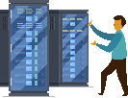







Why GCP?
Cost Effective
Serverless
Highly Scalable
Cloud AI
Custom Machine Types
Big Data Analytics
Internet of Things
API Platform and Ecosystem
Notes:
Cost Effective : Pay per use
Scalability : Highly Scalable (Auto Scalability)
Customized: Custom Machine Types :
Big Data Analytics : Fully managed data warehousing, batch and stream processing, data exploration, Hadoop/Spark, and reliable messaging
API Platform and Ecosystem: Cross-cloud API platform enabling businesses to unlock the value of data, deliver modern applications, and power ecosystems.
Internet Of Things: Intelligent IoT platform that unlocks business insights from your global device network
Cloud AI: Fast, large scale and easy to use AI services. neural net-based ML service has better training performance andincreased accuracy compared to other large scale deep learning systems.
Serverless : No upfront provisioning - Just provide your code and data, and Google dynamically provisions resources as needed. No management of servers. Applications with rapid time-to-market and unpredictable scale requirements benefit the most from Serverless

Slide 18
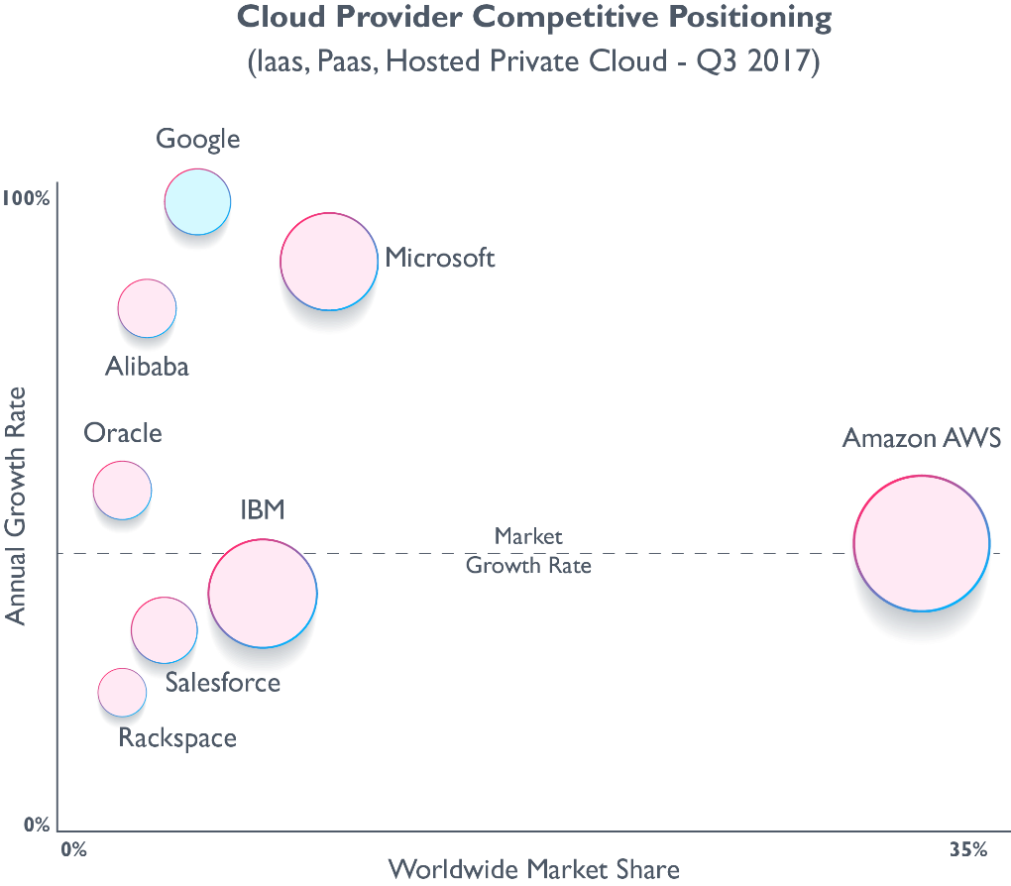
Why GCP?
Source: Synergy Resource Group

Slide 19
What is Google Cloud Platform?

Slide 20
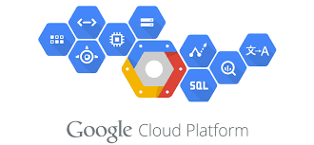
What is GCP?
Google Cloud Platform, is a suite of cloud computing services and management tools offered by Google
Alongside a set of management tools, it provides a series of modular cloud services including computing, data storage, data analytics and machine learning

Slide 21
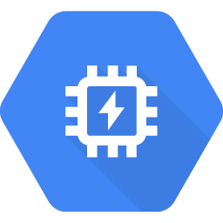
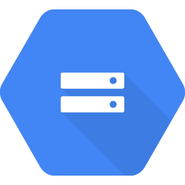
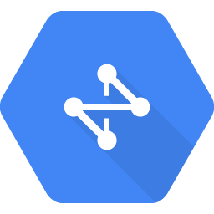



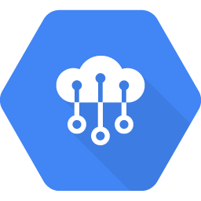
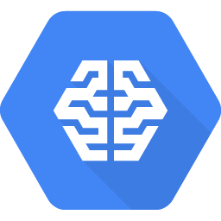
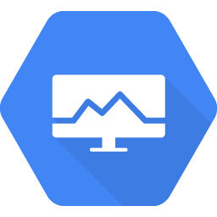
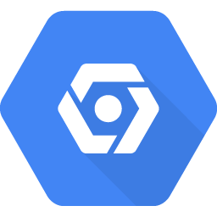
Google Cloud Platform Services
Compute
Storage & Database
Networking
Big Data
Developer Tools
Identity & Security
Internet of Things
Cloud AI
Management Tools
Data Transfer

Slide 22
GCP Regions and Zones

Slide 23
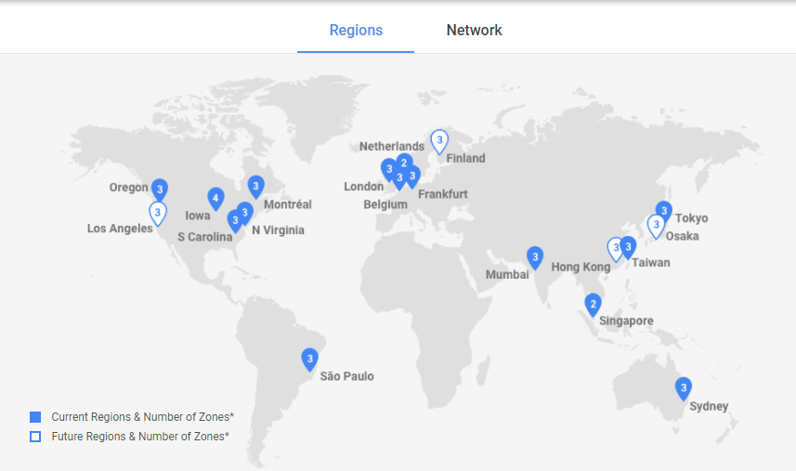
GCP Regions and Zones

Slide 24
GCP Regions and Zones
Global Resource or Multi-regional resource
(BigQuery, Datastore, Cloud Storage)
Regional Resource
(App Engine Instance)
Zonal Resource
(VM instance
&
disks)

Slide 25
Creating account on GCP

Slide 26
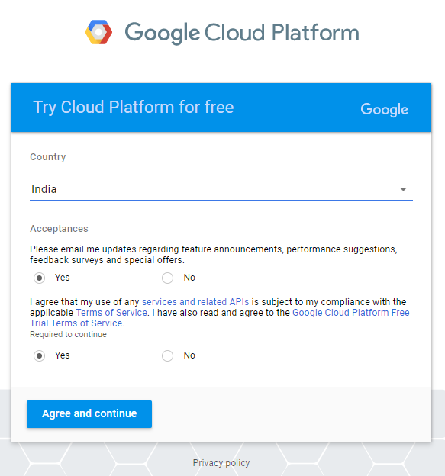
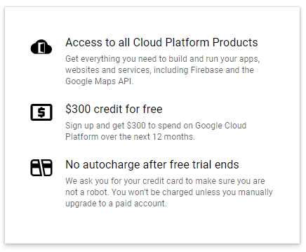
Creating Free Account

Slide 27
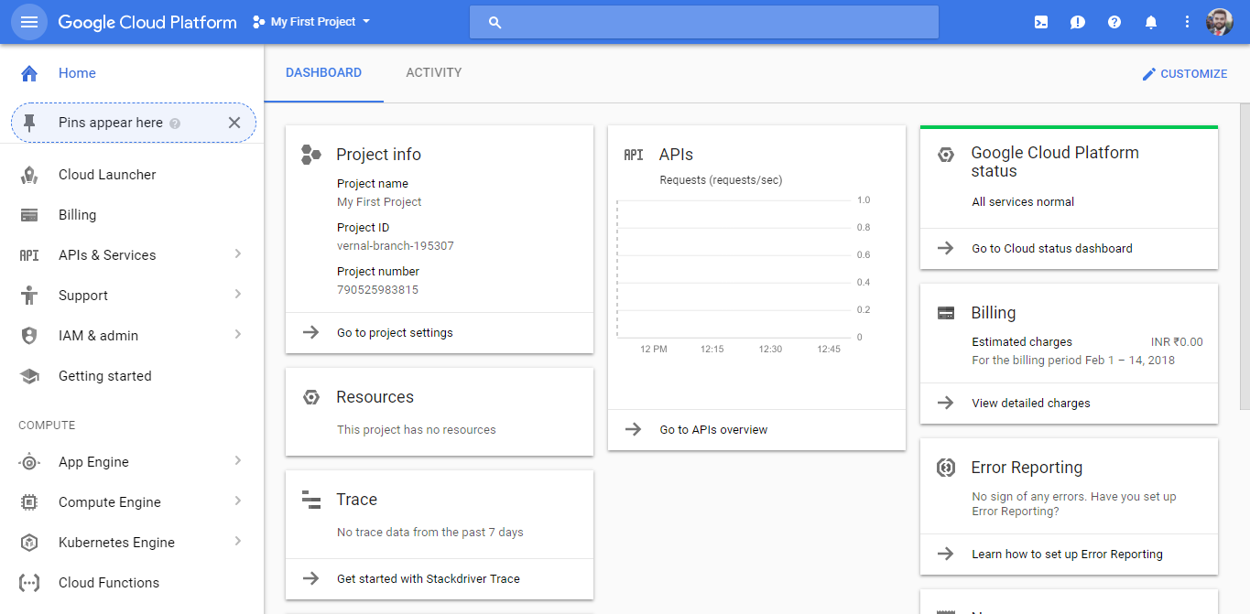
GCP Home
Notes:
All GCP services are associated with Project
By default a project is created when you Sign Up
Project Identity:
Name
Number
ID
Using Project, you can :
Enable Billing
Track resource usage
Manage permissions
Enable different services
Access APIs

Slide 28
GCP Services in Depth

Slide 29

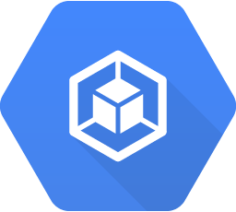
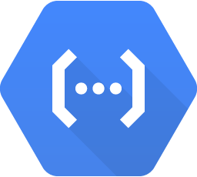
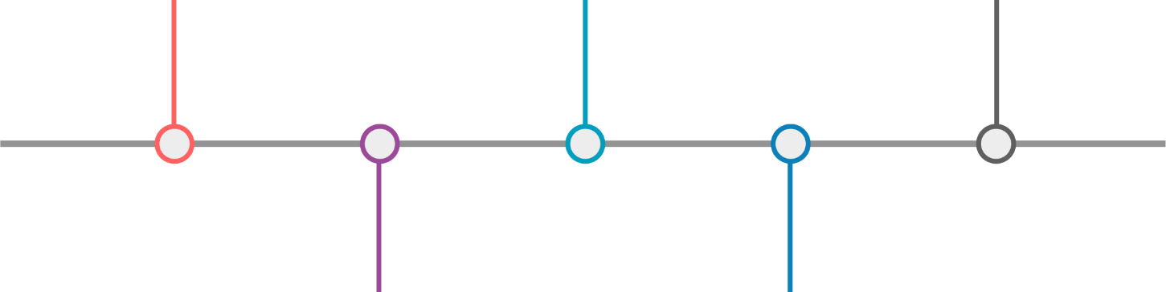
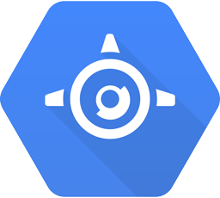
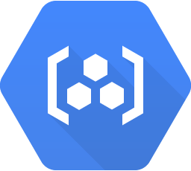
Compute
App Engine
Container Registry
Compute Engine
Container Engine
Cloud Functions
Notes:
From global, load-balanced, resilient services to flexible single-instance VMs, we provide a scalable range of computing options you can tailor to match your needs. Google Compute Engine provides highly customizable virtual machines with best-of-breed features,

Slide 30

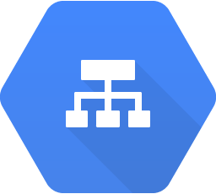
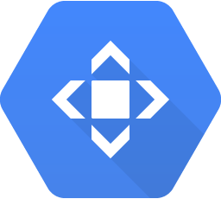
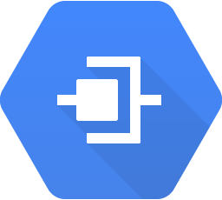
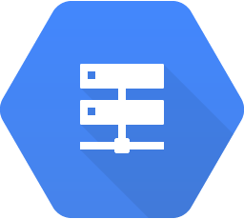
Networking
Cloud Virtual Network
Cloud Load Balancing
Cloud CDN
Cloud Interconnect
Cloud DNS

Slide 31

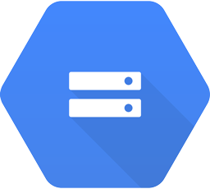
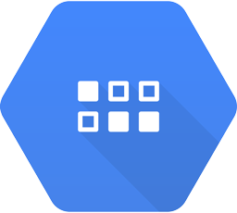
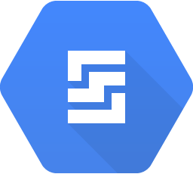
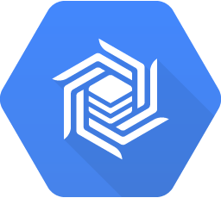
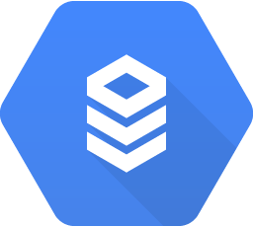
Storage and Databases
Cloud Bigtable
Cloud SQL
Cloud Storage
Cloud Datastore
Persistent Disk

Slide 32

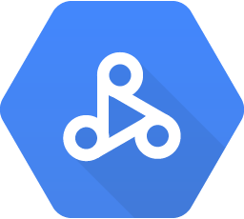
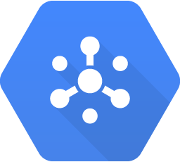
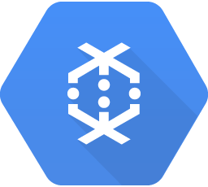

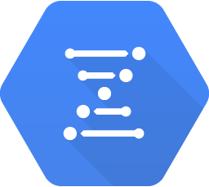
Big Data
BigQuery
Dataproc
Pub/Sub
Dataflow
Datalab
Genomics

Slide 33
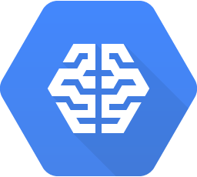

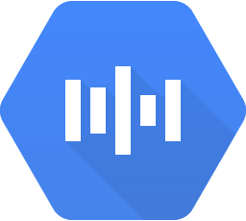
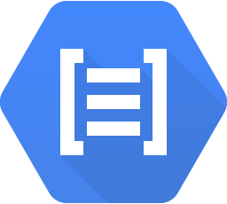
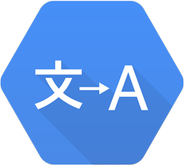

Machine Learning
Cloud Machine Learning
Speech API
Translation API
Vision API
Natural Language API
Jobs API

Slide 34



Identity & Security
Cloud Resource Manager
Cloud IAM
Cloud Security Scanner
Cloud Platform Security

Slide 35








Management and Developer Tools
Management Tools
Stackdriver
Monitoring
Logging
Error Reporting
Trace
Debugger
Cloud Shell
Cloud Mobile App
Deployment Manager
Cloud APIs
Cloud Endpoints
Cloud Console
Developer Tools
Cloud SDK
Deployment Manager
Cloud Source Repositories
Cloud Tools for Android Studio
Cloud Tools for IntelliJ
Cloud Tools for PowerShell
Cloud Tools for Visual Studio
Google Plug-in for Eclipse
Cloud Test Lab

Slide 36


